Slide 1
PRESENTATION ON Hospital Management System

Slide 2
Project title:-Hospital Management System
group Members :-
1) Vinayak konapure (3547)
2) yogesh jindam (3552)
3) aryan pawer (3559)
4) TEJAS SADAFULE (3551)

Slide 3
Abstract
The purpose of the project entitled as “HOSPITAL MANAGEMENT SYSTEM”
is to computerize the front office management of hospital to develop software which is user friendly simple, fast, and cost – effective. It deals with the collection of patient’s information, diagnosis details, etc. traditionally, it was done manually . The main function of the system is register and store patient details and doctor details and retrieve these details as and when required, and also to manipulate these details meaningfully system input contains patient details, diagnosis details, while system output is to get these details on to the screen. the hospital management system can be entered using a username and password. it is accessible either by an administrator or receptionist. only they can add data into the database. the data can be retrieved easily. The data are well protected for personal use and makes the data processing very fast.

Slide 4
Index:-
1. INTRODUCTION
1.1 Introduction
1.2 Problem introduction
1.3 Modules in the project
2. REQUIREMENTS SPECIFICATION
2.1 Hardware requirements
2.2 Software requirements
3. TESTING
3.1 Advantages
3.2 Disadvantages
3.3 Screenshots

Slide 5
1. INTRODUCTION :
1.1 Introduction:
The project Hospital Management system includes registration of patients, storing their details into the system, and also computerized billing in the pharmacy, and labs. The software has the facility to give a unique id for every patient and stores the details of every patient and the staff automatically. It includes a search facility to know the current status of each room. User can search availability of a doctor and the details of a patient using the id . The Hospital Management System can be entered using a username and password. It is accessible either by an administrator or receptionist. Only they can add data into the database . The data can be retrieved easily. The interface is very user-friendly. The data are well protected for personal use and makes the data processing very fast . Hospital Management System is powerful, flexible, and easy to use and is designed and developed to deliver real conceivable benefits to hospitals . Hospital Management System is designed for multispeciality hospitals, to cover a wide range of hospital administration and management processes.

Slide 6
1.2 Problem Introduction:
Lack of immediate retrievals: -
The information is very difficult to retrieve and to find particular information like- E.g. - To find out about the patient’s history, the user has to go through various registers. This results in in convenience and wastage of time.
Lack of immediate information storage: -
The information generated by various transactions takes time and efforts to be stored at right place.
Lack of prompt updating: -
Various changes to information like patient details or immunization details of child are difficultto make as paper work is involved.

Slide 7
1.3 Modules in the project :
The entire project mainly consists of 7 modules, which are
Admin module
User module (patient)
Doctor module
Nurse module
Pharmacist module
Laboratorist module
Accountant module

Slide 8
2. REQUIREMENTS SPECIFICATION :
2.1 Hardware requirements :
PROCESSOR : Intel dual Core ,i3
RAM : 1 GB
HARD DISK : 80 GB

Slide 9
2.2 Software requirements :
OPERATING SYSTEM :Windows 7/ XP/8
SERVER SIDE SCRIPT : Php
DATABASE : Mysql
WEB TECHNOLOGIES : ASP.NET 2.0

Slide 10
3.TESTING :
3.1 : ADVANTAGES :
It is possible to access every data from anywhere in the world specifically via authorized login.
This mode of communication has become relatively cheaper.
The integration of the software into the system has made communication much more effective in the case of the health care system
The integral reports can be sent through instant messages, emails, etc.
This has ultimately given shape to a completely new type of system.

Slide 11
3.2 Disadvantages :
Hospital management system is generally related to security. It is considered to be a matter of concern in case you go online without enough protection which can create some big problems related to security.
Another problem that is associated width hospital management is the data breach. It is also known to be a sophisticated problem.
Lack of employment is another such thing.
The chances of employment usually become less with the automation of the system.
The gradual need for manual data drafting becomes an irrelevant aspect.

Slide 12
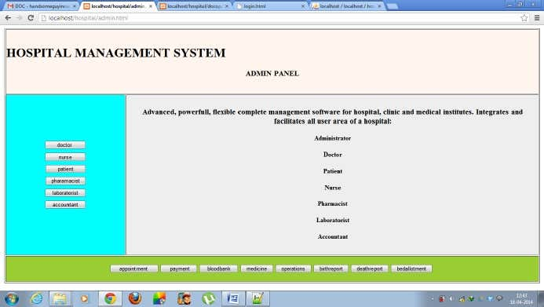
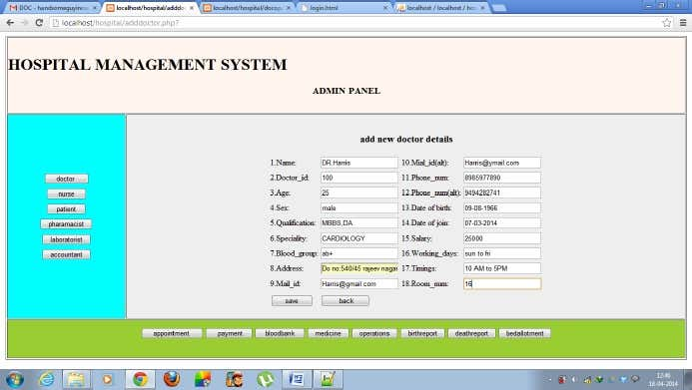
Output :-

Slide 13
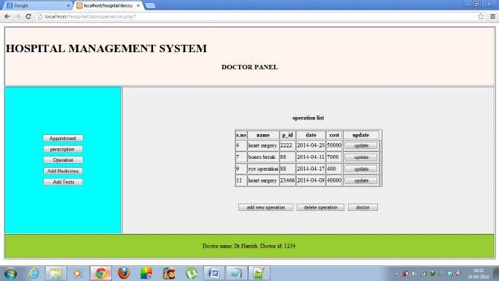
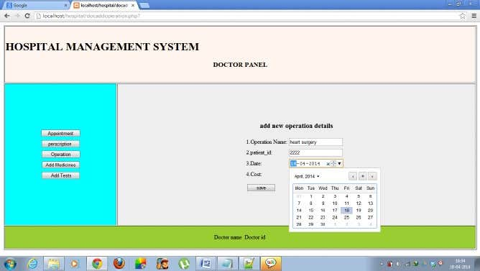

Slide 14
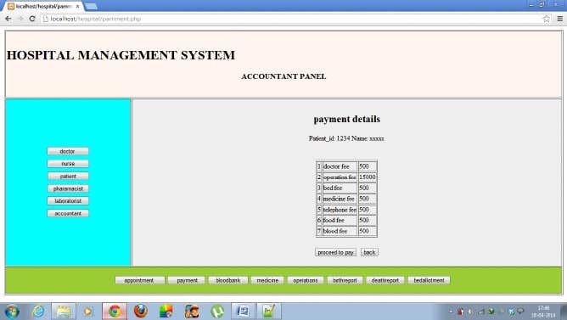
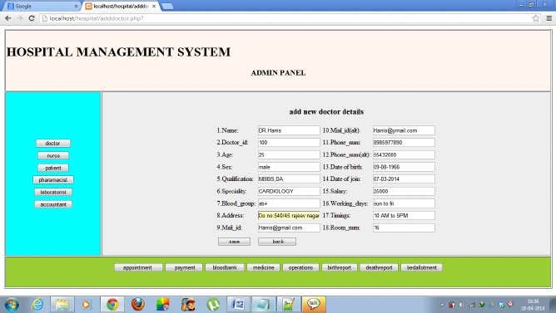

Slide 15
THANK YOU

